Slide 1

GUVI Geek Network Pvt Ltd
Notes:
Need to convert these points into icons with text

Slide 2

Popular SDLC Models
  Waterfall Model
  V-Model
  Agile Model
  Spiral Model
  Incremental Model
  Iterative Model
  Big Bang Model
https://www.guvi.in/

Slide 3
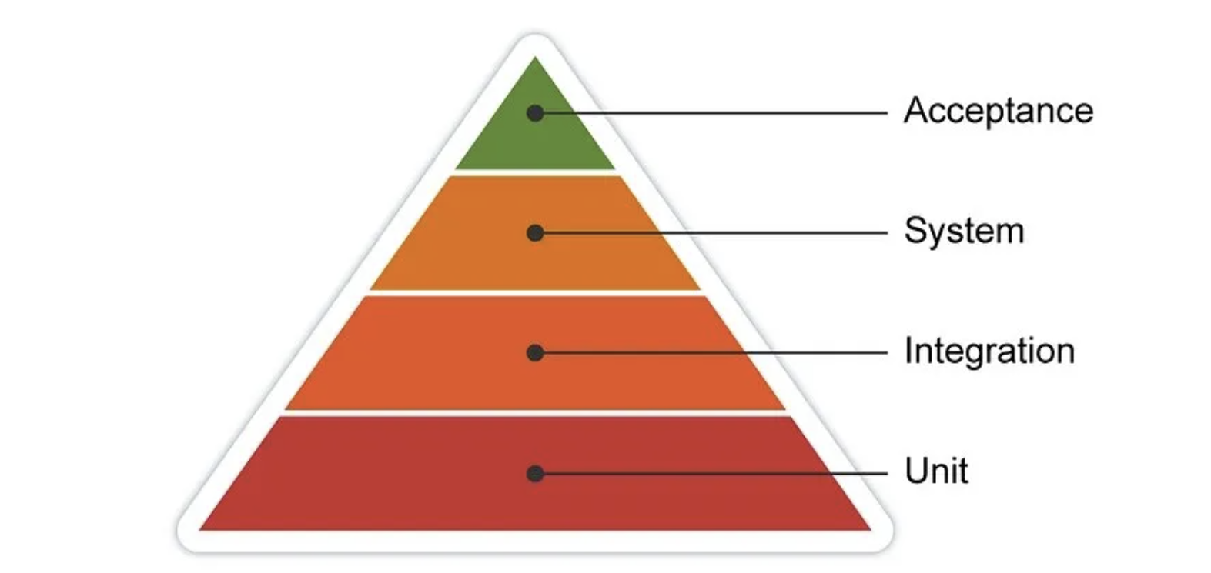
https://www.guvi.in/

Slide 4
Level | Focus | Performed By | Purpose
Unit | Single module | Developer | Check functions
Integration | Module Interaction | Dev/Testers | Check connections
System | Whole system | Testers | Verify system
Acceptance | Business needs | Client | Validate requirements
https://www.guvi.in/

Slide 5
Thank You
https://www.guvi.in/

